Slide 2
Av-Tech Industries- Quality, Service and Precision Kitting
Av-Tech is a proven quality supplier of Kits to ULA, Lockheed Martin, Macro Industries and Northrop Grumman.
Quality starts with inspection and verification of all components to customer requirements.
Our quality services include controlled secure storage and electronic tracking of all components throughout the inspection, validation, kitting and shipping processes.
Av-Tech now provides the highest level of precision kitting in the industry utilizing the MAAG Kit system. We also specialize in Bag & Tag Kitting and smaller tackle box style kits.

Slide 3
Av-Tech Industries Final Inspection and Shipment of Kits
Assembly and verification of Kit Configuration to BOM
Final inspection to include FOD control
Processing of test reports and certifications
Source Inspection of completed Kits if required
Security to prevent tampering until point of use if required
Uploading of all required documentation to customer site
Packaging and shipping of Kits per customer requirements

Slide 4
Benefits and Features of Kitting
Kitting increase overall productivity
Kitting reduces lost assembly time
Delivery direct to Point of Use
Kitting contains all parts required for specific assemblies
Defect free hardware
MAAG Kits reduced FOD due to:
Less handling by technician
Greatly reduced packaging (bags and labels)

Slide 5
Benefits to Customer
Lower procurement costs due to purchasing total kit quantities for better pricing
Lower production costs through time savings
Reduced installation costs
Reduce total inventory investment
Turn around time is greatly reduced
MAAG Kits and tackle box style kits are reusable for many ship sets
Flexibility in revisions of kits (simple cell changes with MAAG Kits)
Greatly reduced potential for packaging errors
Reduced escapes due to FOD, Quantities and hardware damage

Slide 6
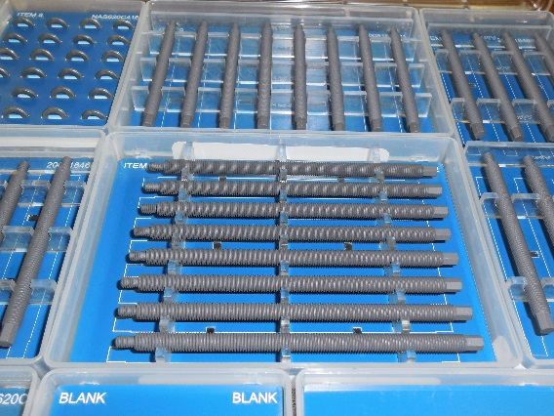
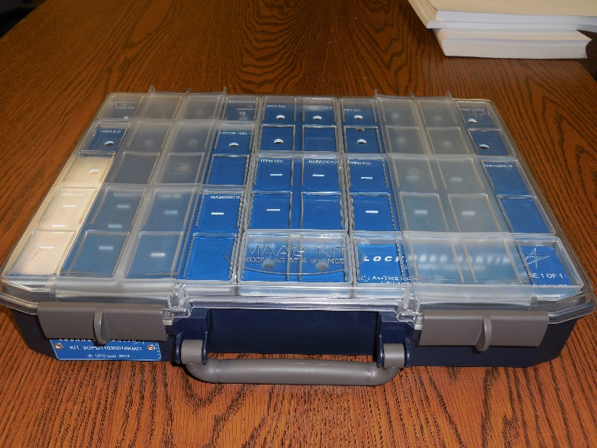
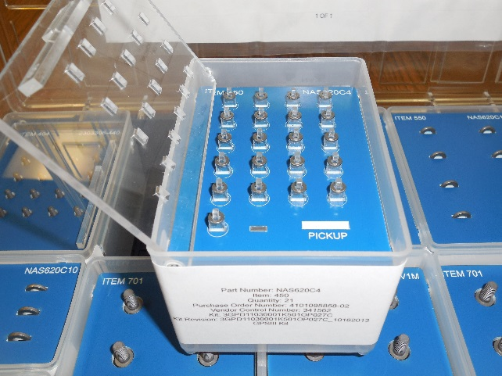
Sample Kits – MAAG Kits

Slide 7
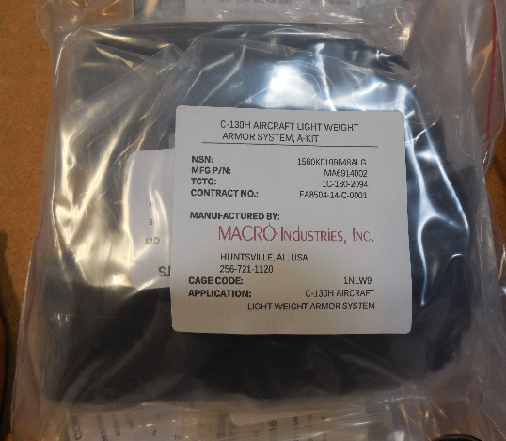
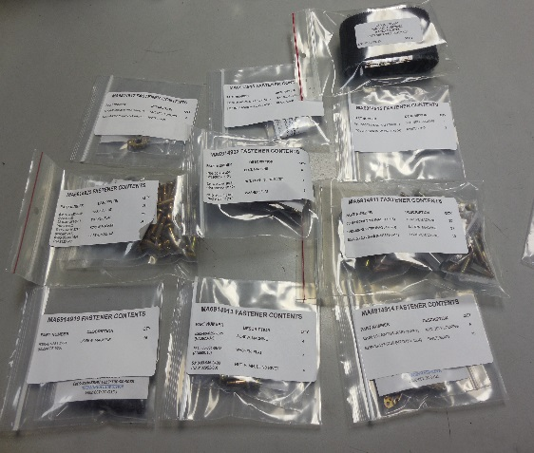
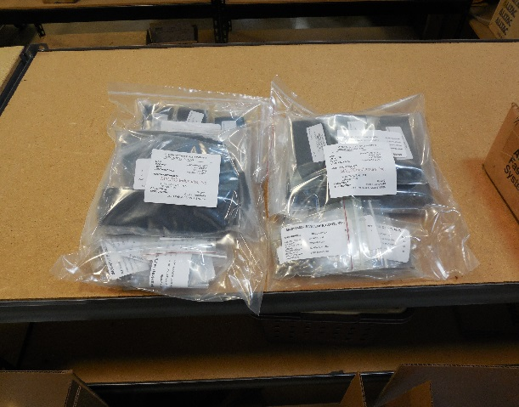
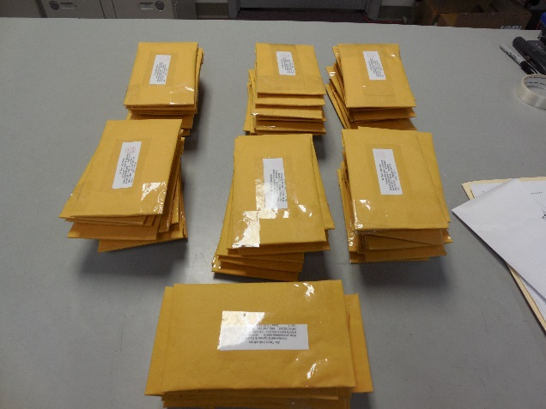
Sample Kits – Bag & Tag Kits

Slide 8
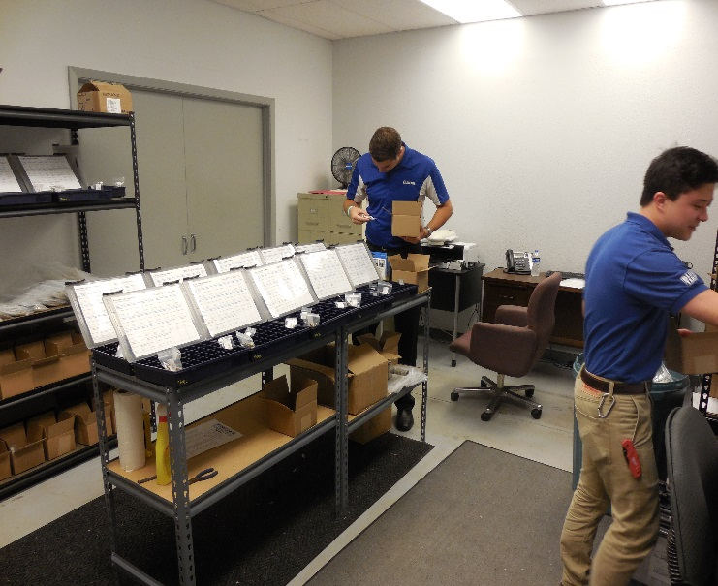
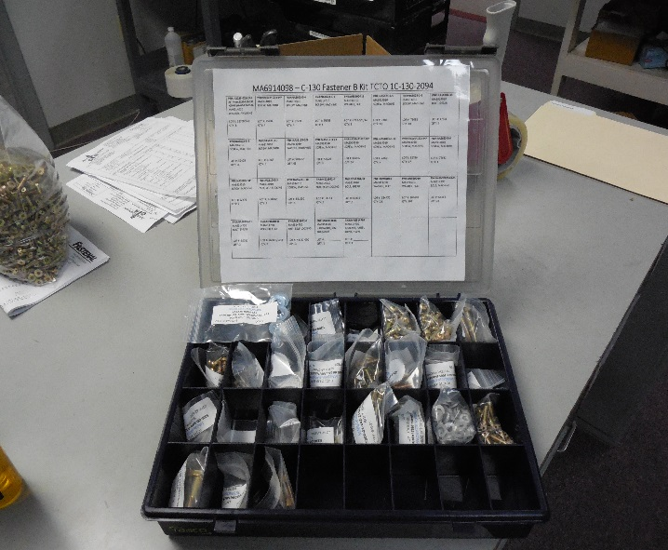
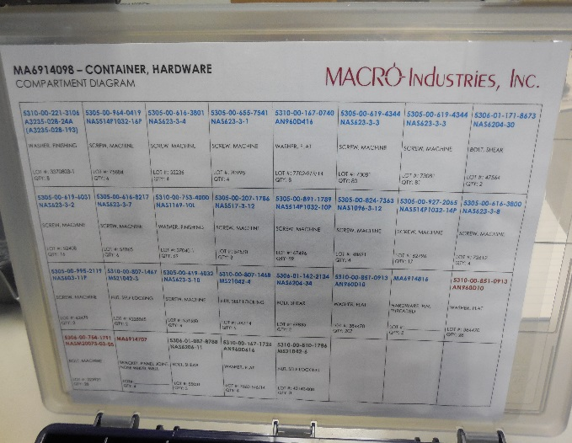
Sample Kits – Tackle Box Kits

